Slide 1
Cyber Threat Anomaly Detection
Blake Cox, Matthew Forey, Priscilla Muniz, Kiana Faeghi Rad
Notes:
Good morning
This is Priscilla, Kiana, Matt and I’m Blake
And today we will be talking about utilizing anomalies to detect potential cyber threats

Slide 2

Anomaly
Unusual behavior or pattern of data
Notes:
When I refer to an anomaly I’m talking about unusual patterns
If we use your personal computer as an example
What we should see is one username password, or loggin attempt and one success
It would be unusual to see 176 attempts and 1 success
And where would we see this information?

Slide 3
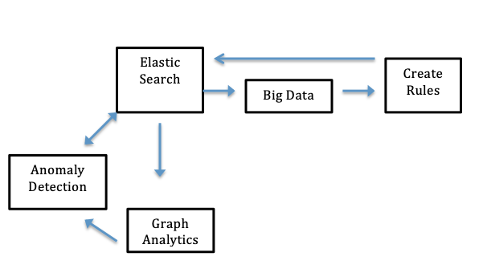
Process Flow
Notes:
This process flow explains how we get the data and what happens after it’s collected
And it all centered around the elasticsearch platform in Kibana
There are two ways to go about detecting anomalies
The first way is using big data methods
Extracting data from elasticsearch into jupyter to process using classification or clustering
Once we have manageable data we create rules to upload back into elasticsearch to create more useable filters
The second way is using graph analytics
Elasticsearch is similar to SAS enterprise guide in that its mostly a point and click platform with the ability to input simple code if necessary
We can play with it through trial and error to see what filters make sense, what has an association with another filter, and really provide that data analytics type of research
Everything begins and gets put back into elasticsearch

Slide 4
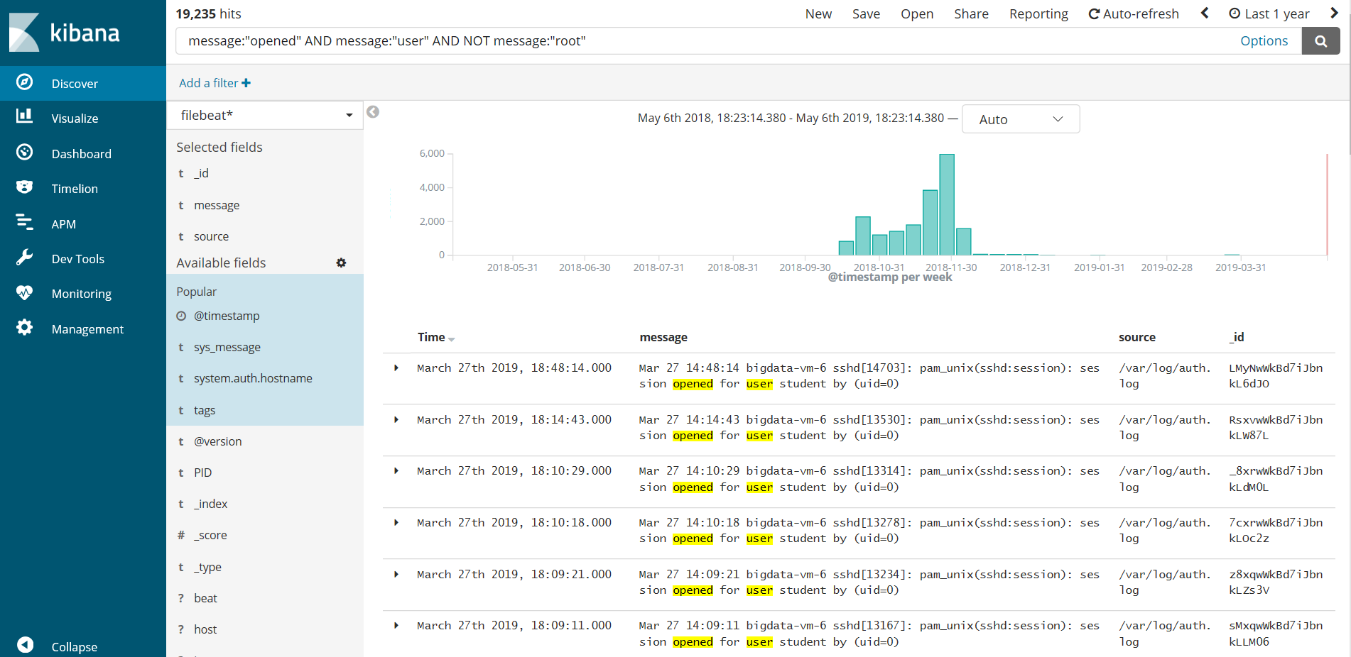
Sample Kibana Screenshot
Notes:
This is what the query section looks like in elasticsearch
You provide filters and some type of query and kibana provides an output
When we’re referring to logs what we’re talking about is this middle section that begins with the time stamp and then a message
All of our data is collected through this kibana platform

Slide 5
Data Overview
Big Data Project
Data collected from 54 servers over a period of 4 months
Over 75 million individual log observations
Over 15 million Network flows collected from the same cluster
Data Weight
OS logs: 9.13 GB
Network Flows: 1.7 GB
Data Processing Architecture:
192 GB RAM
48 threads
256 GB SSDs
2 TB storage
Data Analytics in Unstructured data
sshd message repeated times failed password for root from port ssh
Notes:
Let’s talk about our data
This is a big data
But we learned that in the real world datasets as large and larger are consistently worked with in cyber security
The data we used was collected over a 4 month period and contained over 75 million log observations and 15 million network flows
The pickle file we processed in jupyter was over 9 GB and nt flows was almost 2 GB
The power behind this research was not on our own laptops.
We were able to utilize a network with
192 GB RAM
48 threads
256 GB SSD
And 2 TB storage
So this is an example of data analytics in unstructered data
This was one of our message outputs.
It’s difficult to make sense from this especially because these words may not be right next to each other in the actual kibana message

Slide 6
Objective
Preprocess OS logs
Collection
Cluster / Classify
Data representation
Produce Graph Analytics
Visualize Network Flows
Cyber Threats
Traffic Analysis
Notes:
Our objective for this project consisted of 3 parts
We needed to classify log messages into useful data
We also needed to produce graph analytics to drive future decisions
And finally we were to provide a network flow visualizing cyber threats

Slide 7
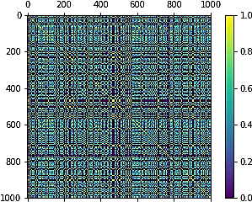
Method
OS Log Classification
TF-IDF
NLP
NLTK
Tokenization
LDA
Lemmatization
Graph Analytics
OS Log Classification Rules
Kibana ElasticSearch
Network Flows
Kibana ElasticSearch
Notes:
TF-IDF was our first technique in dealing with the log files
Fortunately and unfortunately it worked
Fortunately because we spent so much time on it
But unfortunately it produced too pretty of a picture
TF-IDF didn’t take into account the location of individual words in each message
With the help of Nima we used Tokenization to create a key value paired dictionary with action words from each log.
Lemmitazation worked: route taken

Slide 8
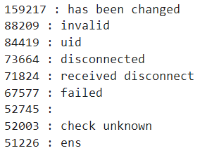
Results
OS Log Classification
Key/value pair dictionary
33 different filters
98.6% of all messages
Notes:
TF-IDF was our first technique in dealing with the log files
Fortunately and unfortunately it worked
Fortunately because we spent so much time on it
But unfortunately it produced too pretty of a picture
TF-IDF didn’t take into account the location of individual words in each message
With the help of Nima we used Tokenization to create a key value paired dictionary with action words from each log.
Lemmitazation worked: route taken

Slide 9
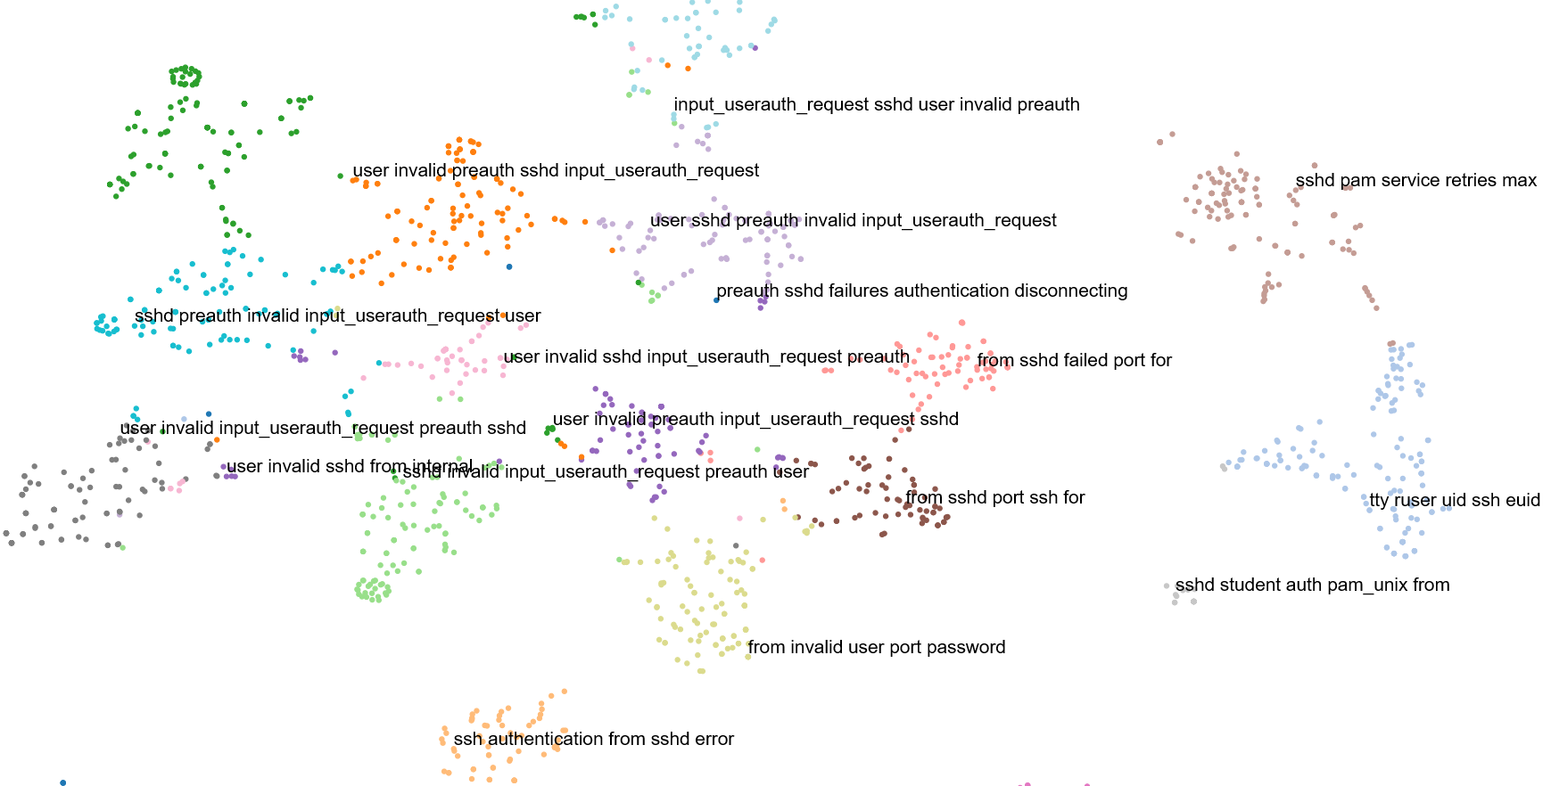
Results
Notes:
Utilizing NLTK we were able to group our messages into usable clusters

Slide 10
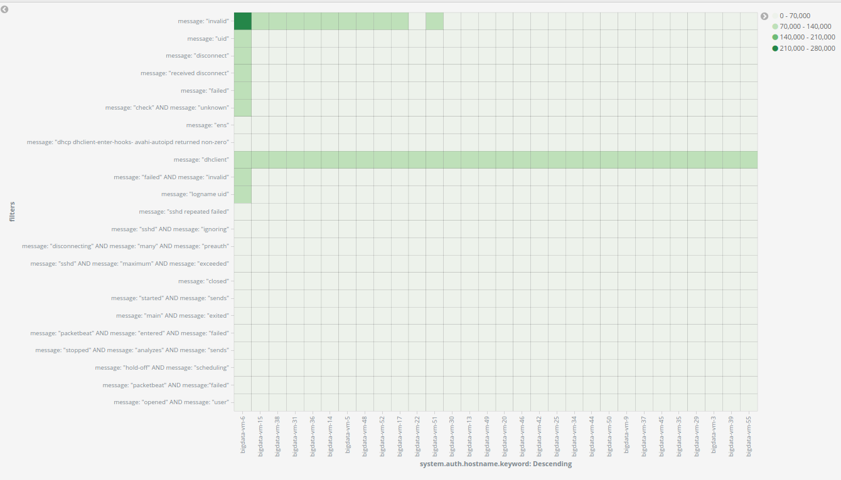

Slide 11
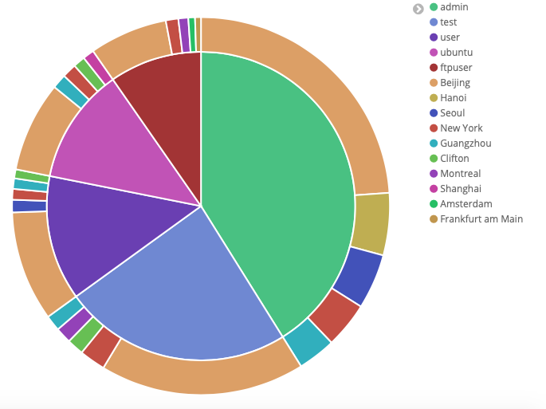
Cyber Threats Analytics
using Network Flows:
To detect anomalies using network traffic.
Source: Kibana
Failed Password Last 90 Days by ‘User’ and ‘City’
Notes:
We used network flows to conduct our Cyber threat analytics
Network flows can be used to generate graph analytics to further understand communication occurring between the machine, internal and external sources and detect anomalies using network traffic. Here we have a search that contains Results of 137,000 hits showing where the top users who tried to access our system were located throughout the world.
Top users:
-admin (41.11%) {within admin - 58% in Beijing, 13% in Hanoi, etc.}
-test (23.92%)
-user (13.09%)
-ftpuser (9.68%)
-ubuntu (12.19%)
Search Buckets (sub-categorize):
Geoip.city_name:
-admin:
-Beijing (58%)
-Hanoi (12.96%)
-Seoul (11.48%)
-New York (9.57%)
-Guangzhou (7.91%)
-test:
-user
-ftpuser
-ubuntu

Slide 12
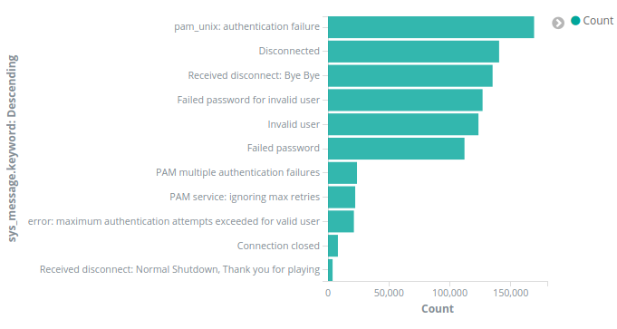
Failed Password Last 90 Days
System messages for attempted logins during the last 90 days
Source: Kibana
Notes:
Another Kibana visualization depicting attempted logins into our system and corresponding messages during the last 90 days for a sample size of our data in our environment

Slide 13
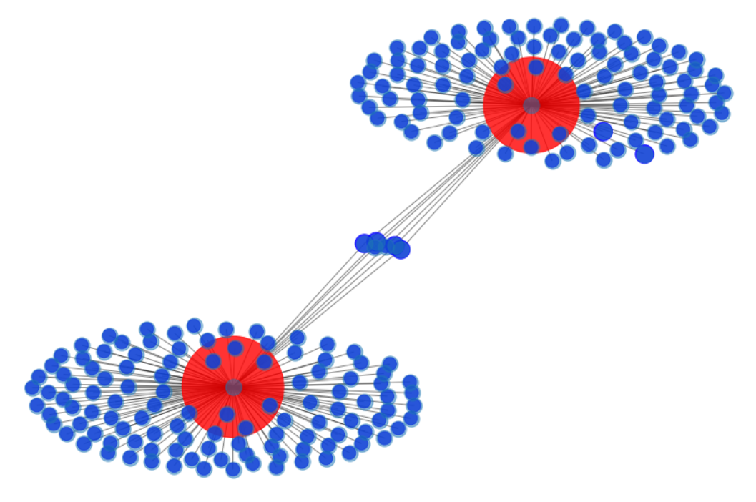
Network Flow

Slide 14
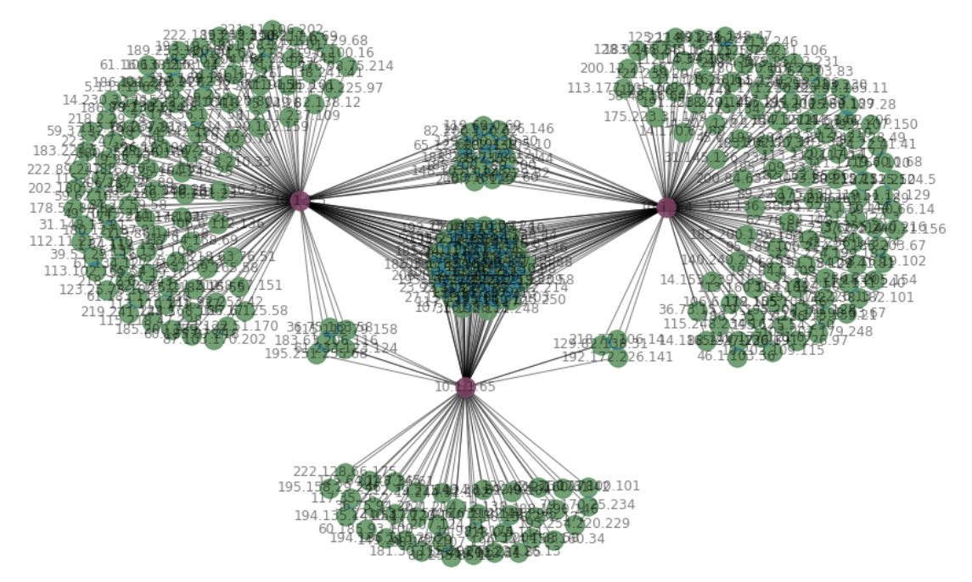
Network Flow

Slide 15
Way Forward
Limitation being time
Complexity of data
Complete 75 million
Notes:
What we didn’t find
What we could continue looking for
We needed more time to process more logs
There is so much that is possible
In process project

Slide 16
Conclusion
Objective
Data Processing
Methods
Results
Way Forward
Questions

Slide 17
Questions
Contact:
Priscilla Muniz
priscilla4muniz@gmail.com
Kiana Faeghi Rad
kianafaeghi@gmail.com
Matt Forey
matt4a10@gmail.com
Blake Cox
blake.cox@my.utsa.edu

